Slide 1

Workshop: Git Version Control
ATTENDANCE
Hacknight #1!

Slide 2
Quick Intro to Hack Nights
ACM Programming Club x KUBI
KU Blockchain & ACM Programming Club are joining forces this semester!
This week’s Hack Night is hosted by ACM Programming Club
Hack Nights are for learning and collaboration
These events will be every Thursday & we will host alternating weeks
Pizza next week
Open to everyone, so bring your friends!

Slide 3

ACM
Student-led club with the directive of education and collaboration in the field of computer science
Meetings - Wednesdays@6PM in LEEP2 G415
Scan here to join our Discord!

Slide 4

KU Blockchain Institute (KUBI)
Student-led research initiative promoting education, research, & development with blockchain technology
Primary meetings - Tuesdays @6PM in Learned 3152
Scan here or come back next week to learn more!

Slide 5


Topics Covered
01
02
03
04
Why use version control?
What is Git?
Git vs. GitHub
Using Git

Slide 6




Git - Common Vocab
Repository - Git’s project folder. Repositories store files and each file’s revision history.
Commit - A commit, or "revision", is an individual change to a file (or set of files).
Staged Changes - Local changes that have not been added to the repository.
Branch - a branch is a new/separate version of the main repository. It can be merged with the main branch

Slide 7

Why use version control?
Collaboration!
Keeping unstable code out of people’s way
Reverting to stable versions!
Large code bases with many developers

Slide 8
What is Git?
Only one of the most used version control systems!
Open-source command line tool!
Where can I get Git?
https://git-scm.com/downloads
Git vs. GitHub
GitHub is a cloud-based Git service.

Slide 9



Commands - Getting Started
Init - Creates a new empty repository
Clone - Creates a local copy of an existing repository
Pull - Downloads and syncs an existing branch

Slide 10



Commands - Controlling Changes
Add - Adds changes to a staged commit
Commit - Creates a commit
Revert - Reverts an executed commit
Status - Displays the current status of git

Slide 11



Commands - Versions
Push - Uploads changes to a git repository
Branch - Creates a new branch in a git repository
Checkout - Switches the working branch
Merge - Combines two separate branches from a git repository

Slide 12
Help Us!
We want to say “Hello hacknight! 🐛” but don’t know where we went wrong, help us out!
https://github.com/delster1/bugSmashers
Notes:
Present until the “Help Us!” slide
Open premade repo
https://github.com/delster1/bugSmashers/tree/main
`git clone reponame`
`git status`
`git branch hotfix`
`git checkout hotfix`
`code .` and fix bug
git add *
git commit -m “fixed bug”
OTHER: `git commit -a -m “New feature!”
The “feature”:
git checkout main
`git merge hotfix`
git push origin --delete hotfix
Fix merge conflicts, profit

Slide 13
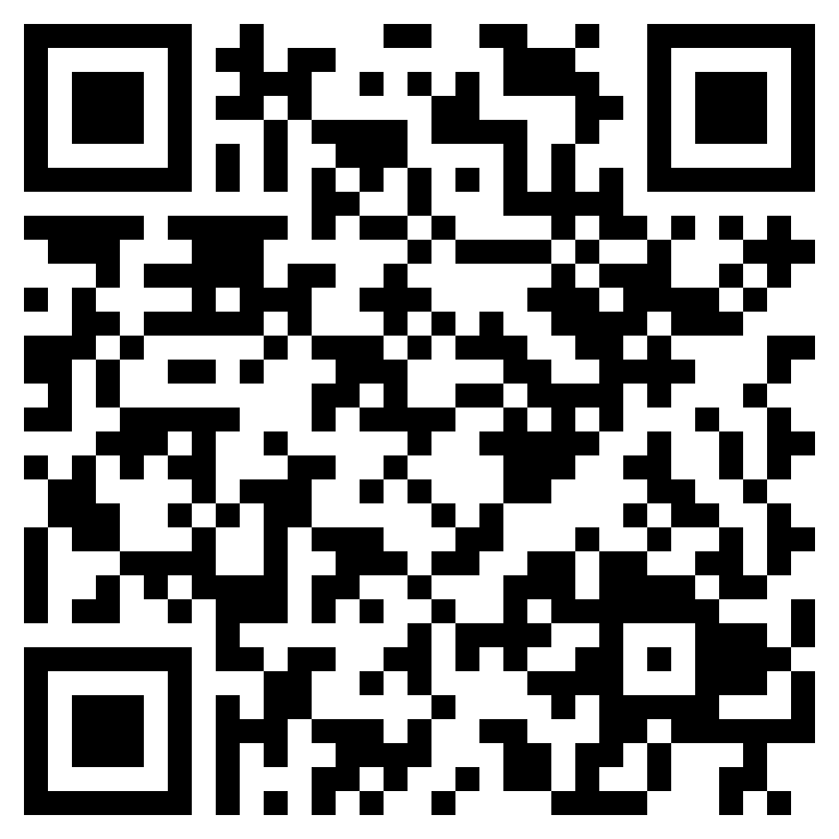
Resources
Cheat Sheet

